Slide 1
Objective
Employ deterministic and probabilistic approaches to simulate bifenthrin concentration in urban runoff
Pair SWMM and VVWM
Identify sensitive input parameters with respect to model output

Slide 2
Motivation / Background
Pyrethroids are often used by Professional Pest Control applicators and homeowners in residential settings
California Department of Pesticide Regulation (CDPR) observed ≥ 1 pyrethroids in 78% of samples, 2009 – 2018
Identified as leading cause of invertebrate toxicity
Pyrethroid detections often exceed US EPA aquatic life benchmarks
Impervious surfaces likely contribute to high observed concentrations
No current models equipped for variability of urban environment

Slide 3
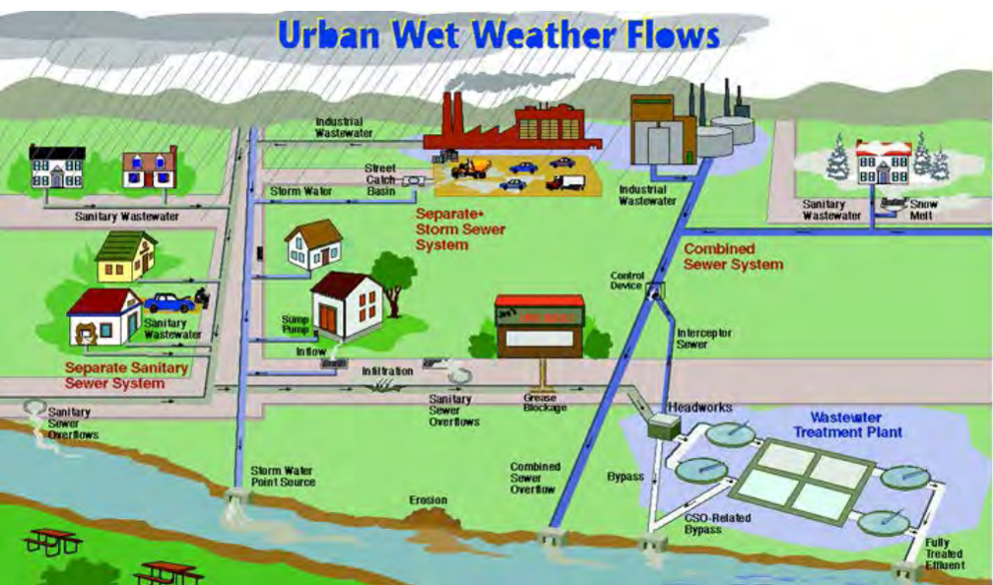
SWMM
Storm Water Management Model (v. 5.1)
Simulates rainfall-runoff scenarios
Runoff component
Subcatchments receive precipitation and generate runoff and pollutant loads
Routing component
Transports runoff from each subcatchments through a series of conduits
Best suited for urban environment
Read SWMM Notes (Generic) and the SWMM User Manual for more in-depth discussion

Slide 4
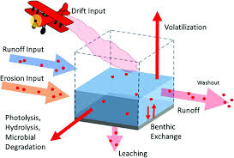
VVWM
Variable Volume Waterbody Model
Simulates water bodies receiving surface runoff
Feed VVWM runoff and bifenthrin outputs from SWMM
Estimates fate and concentration for water column and benthic region

Slide 5
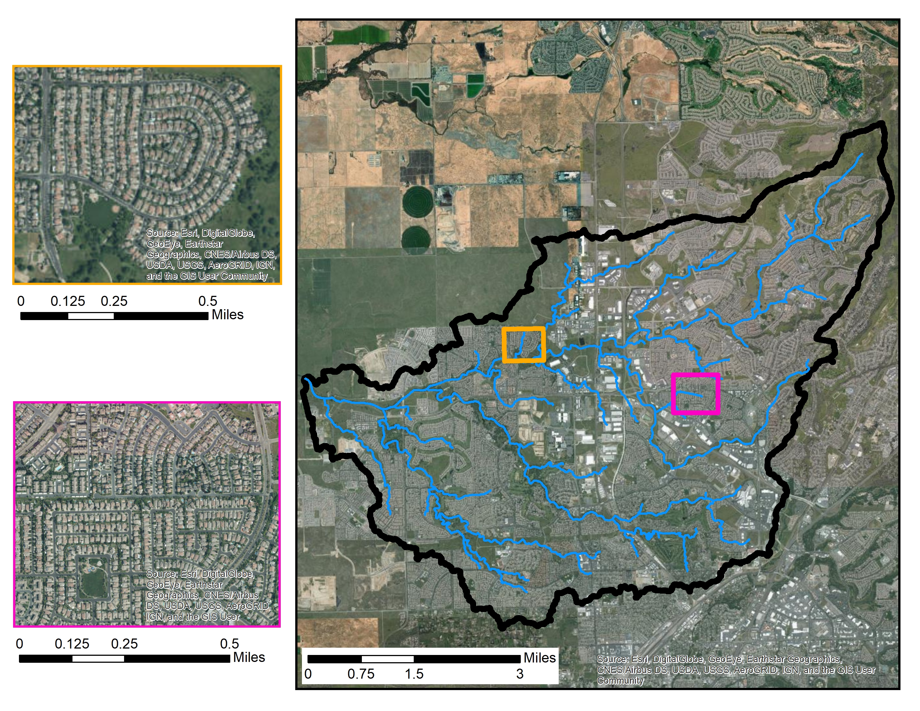
Pleasant Grove Creek
Centered around Roseville, CA
Imagery shows residential, urban layout of our site

Slide 6
Deterministic Approach
Run SWMM Deterministic
Read SWMM .out
Convert units
Construct VVWM input files
Run VVWM Deterministic
Probabilistic Approach
LHS for SWMM params
Read, write SWMM input file with LHS values
Run SWMM Probabilistic
Read SWMM .out
Convert units
Construct VVWM input files
Plotting
Sensitivity Analysis
(In progress)
Run VVWM Probabilistic
Read, write VVWM input file with LHS values
LHS for VVWM params

Slide 7
Base SWMM model
Initial Setup
Created by Sumathy Sinnathamby
Raingages
1 daily precipitation file for entire watershed
Used data collected from HMS
Landuses
Developed (open, low, medium, high)
Other (all other landuses)
Buildup
External time series of application rates for Developed landuse
No buildup for Other landuse
Washoff
Exponential function for Developed landuse (coefficient = 1, exponent = 0.066)
No washoff for Other landuse
* Read GAME PLAN document for more detail

Slide 8
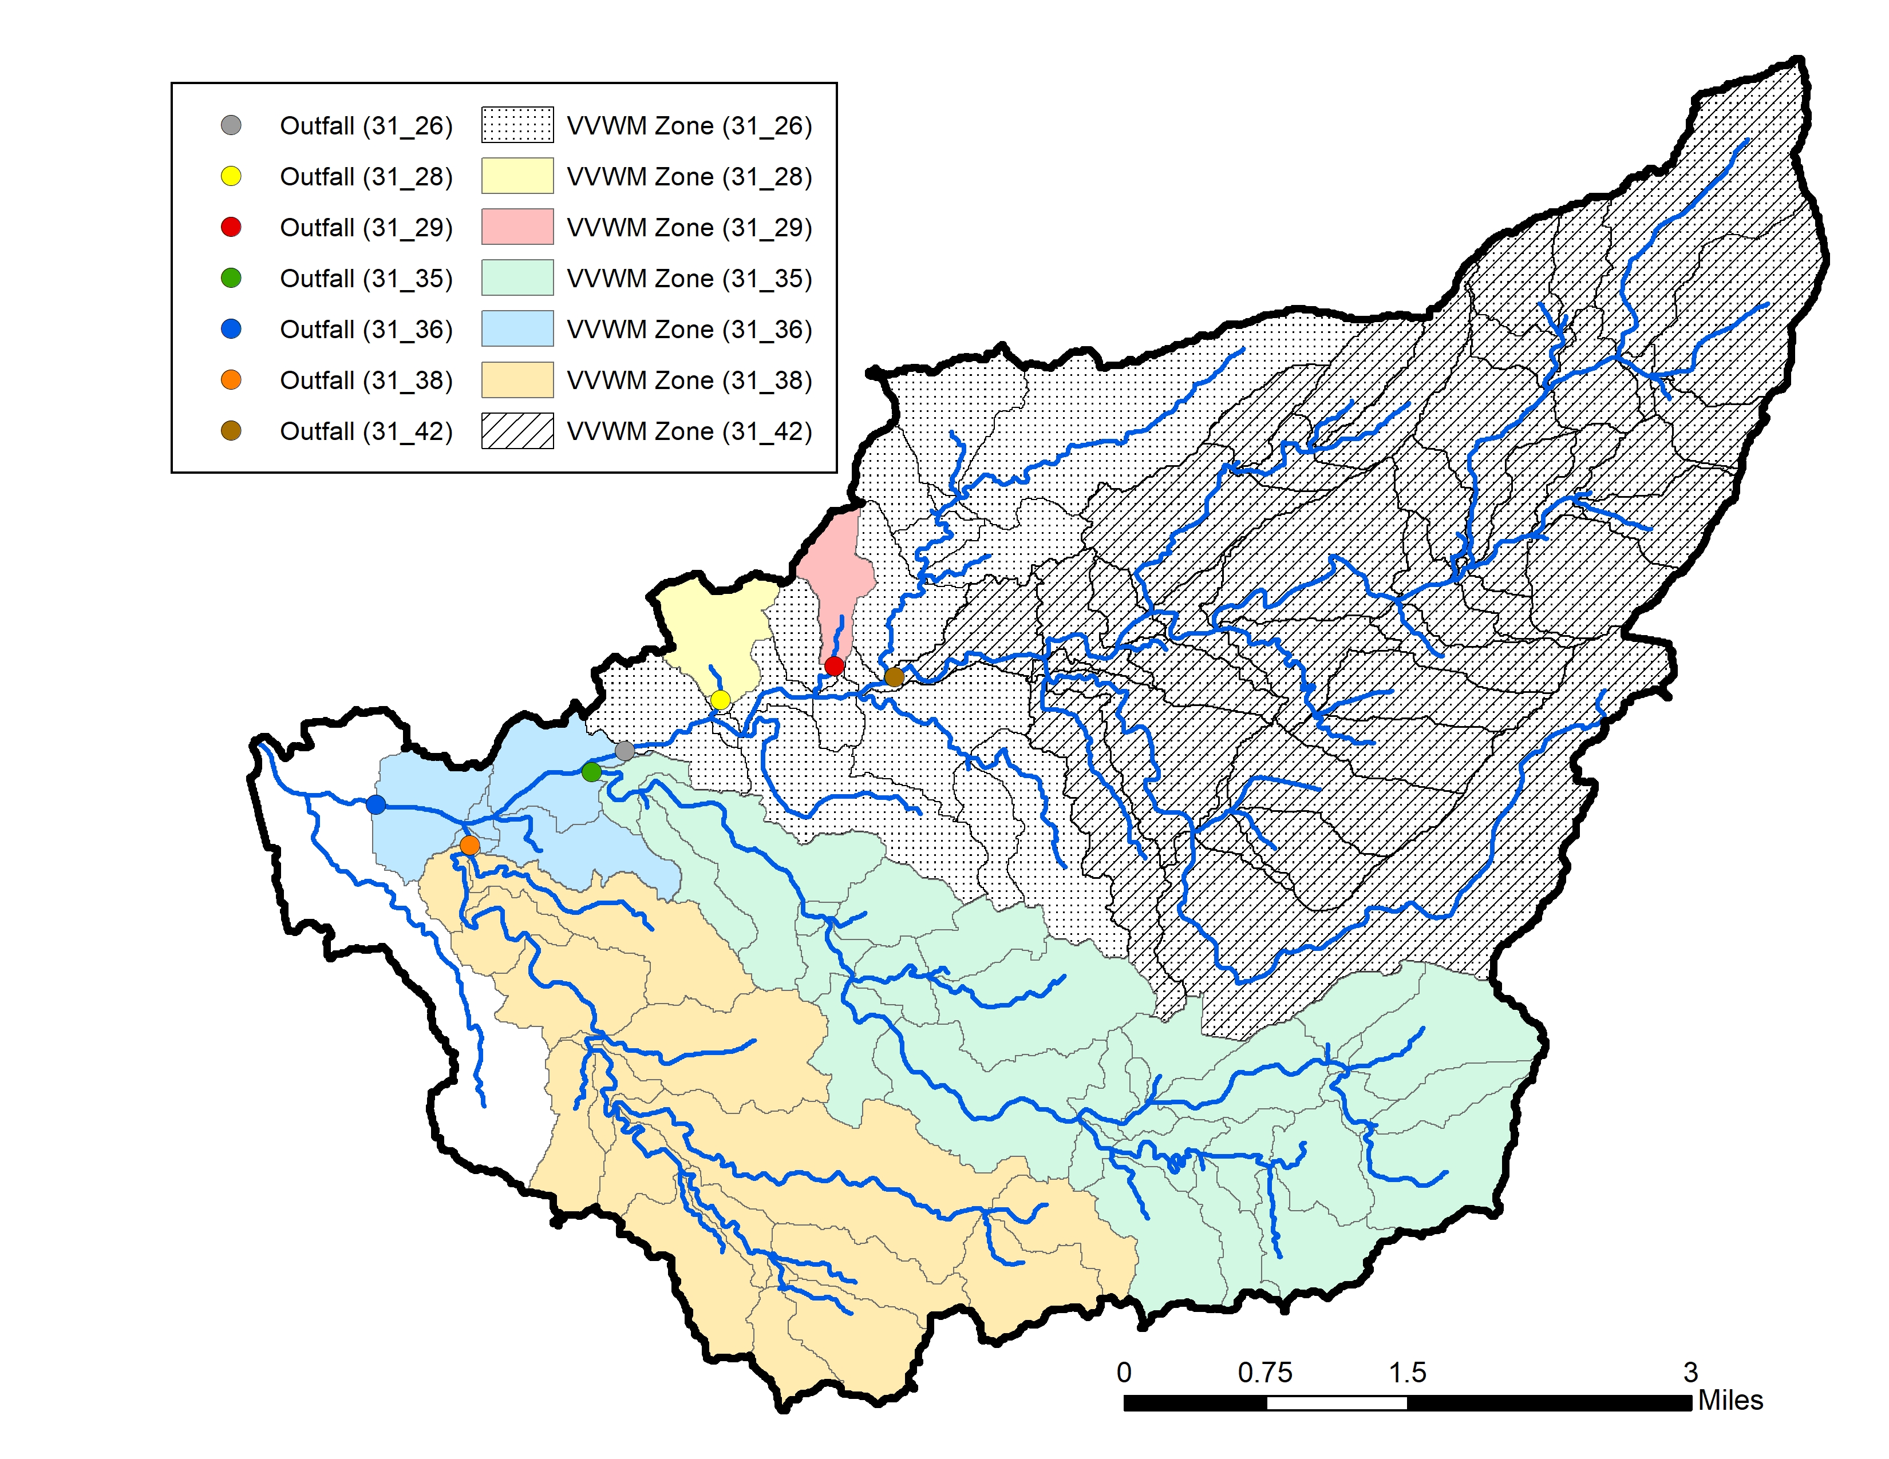
SWMM to VVWM
SWMM outputs (runoff, bifenthrin) are fed into VVWM
SWMM outputs were forked into 7 VVWM runs
Each of the 7 runs has its own receiving waterbody, which coincides with an observed storm drain outfall
The SWMM outputs of the subcatchments whose runoff collects to that outfall are collated into VVWM inputs

Slide 9
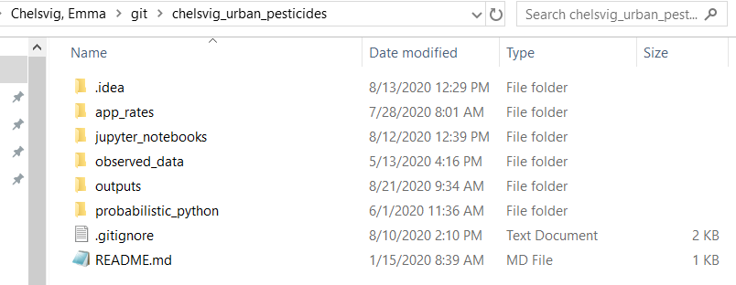
Folder Organization
The preceding slides discuss and explain the folder organization and the files within them.
I recommend going through the scripts in /probabilistic_python/src/ to get a better idea of the project flow and where the files are being incorporated, but these slides will help to provide additional information if you need it.

Slide 10
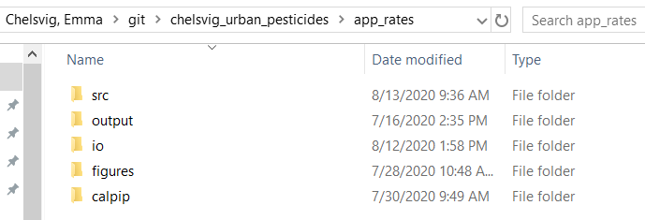
/src/
Scripts that create SWMM’s app rate time series file (01.R – 05.R)
Scripts for assessing the apps input into SWMM vs. the apps that are present in SWMM output (compare.py, compare.R)
/output/
Outputs created during the compare.R script processes
/io/
Input and/or outputs created during the compare.R script processes
/figures/
Figures created during the compare.R script processes
/calpip/
contains the raw data downloaded from the CALPIP PUR database and subsequent files that were created in the data cleaning process
File of importance: /app_rate_output_for_swmm_48rain.txt → the app time series file that is referenced in SWMM simulations

Slide 11
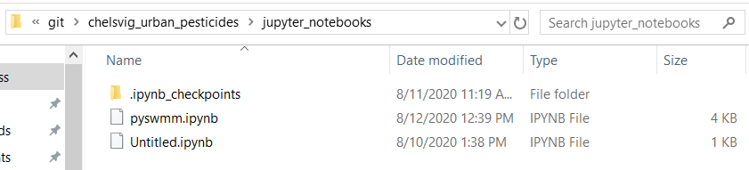
This a just an active rough draft script that I use to test code before running in PyCharm.

Slide 12
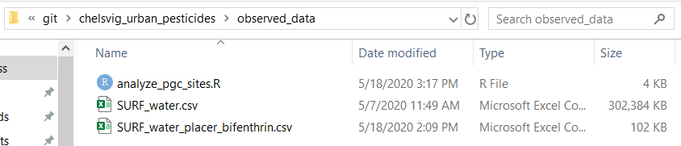
/analyze_pgc_sites.R
Script that filtered the original observed data
Also contains code to look a little at our specific outfalls of interest
/SURF_water.csv
Original observed data
/SURF_water_placer_bifenthrin.csv
Filtered product from the original (pesticide = bifenthrin & county = Placer )
File of Importance
You will use in the future to compare to modeled VVWM output. You will need to further divide this file by the ‘Site_code” to compare to model outputs

Slide 13
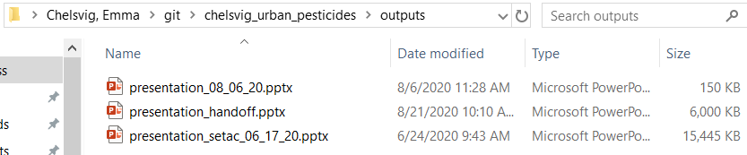
Folder to contain final project outputs
Currently contains various presentations that were created during the project process…none are complete or presentation-worthy at this time

Slide 14
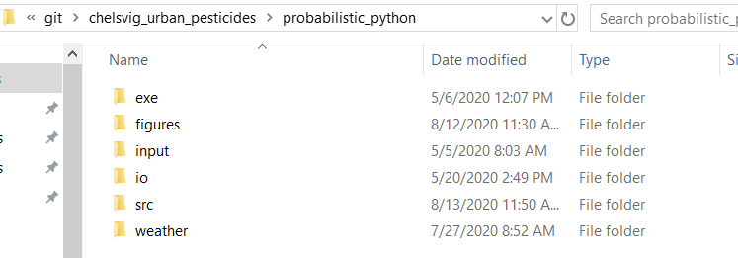
Folder Organization
The preceding slides will discuss the /probabilistic_python/ folder in more detail

Slide 15
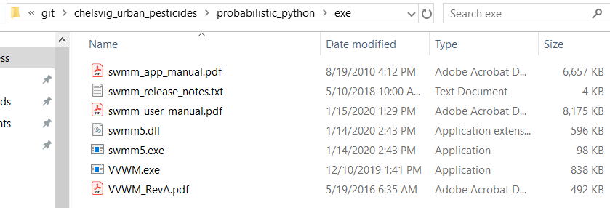
Contains SWMM and VVWM executables, as well as their reference manuals
Files of Importance (both are informative)
/swmm_user_manual.pdf
/VVWM_RevA.pdf

Slide 16
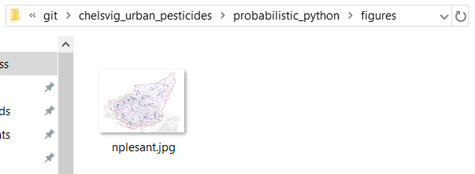
This figure is just referenced in the SWMM input file
Created by Sumathy Sinnathamby in the initial SWMM setup process

Slide 17
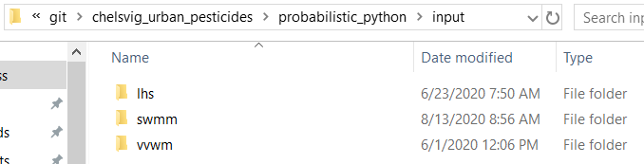
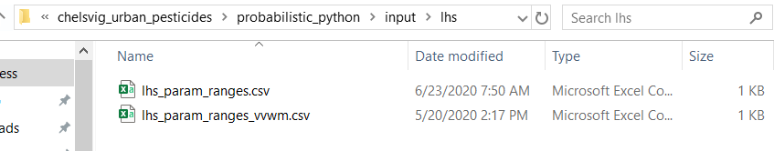
/lhs_param_ranges.csv
Pre-determined ranges when conducting LHS for SWMM variables
/lhs_param_ranges_vvsm.csv
Pre-determined ranges when conducting LHS for VVWM variables

Slide 18
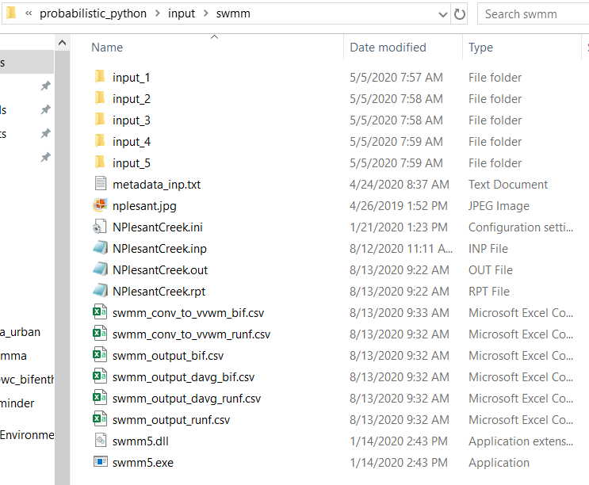
Overall, this is the holding tank for the SWMM side of things. The necessary SWMM info from this folder gets transferred to the input/vvwm/ folder.
/input_/
Folders of importance
Folders that will be created and will contain SWMM files for nsims of the probabilistic process (have only run nsims=5 due to space restraints)
The files within these folders do not reflect the most recent changes in the scripts
/NPlesantCreek.inp
File of Importance
SWMM input file
Serves as the input file for the deterministic SWMM simulation, as well as the base file that the probabilistic simulations are built upon
/NPlesantCreek.out
File of Importance
SWMM binary output file
Output is deciphered and read, and the necessary info is output into the .csv files (script 01b)
/NPlesantCreek.rpt
Another SWMM output file; mainly a general overview of the simulation. We aren’t using this in the process.

Slide 19
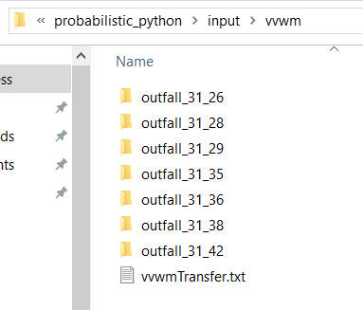
For each simulation, there is a single SWMM run. That SWMM run then gets forked into 7 VVWM runs (whose receiving waterbody coincides with an outfall (“Site_code”) in the observed dataset). The information pertaining to each of these VVWM runs are within their respective folder.
The next slide explains the content in the /outfall_31_26/ folder as an example

Slide 20
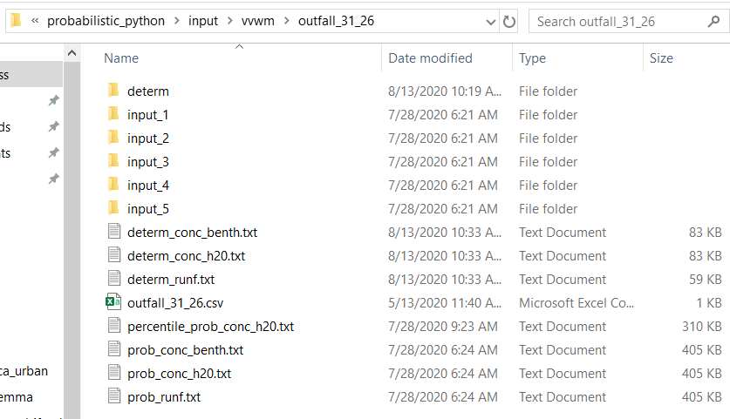
/determ/ contains the VVWM simulation files for the deterministic approach
vvwmTransfer.txt
File of Importance
VVWM variable info is contained here
output.zts
File of Importance
SWMM outputs are converted to VVWM units and compiled into this file
vvwm_wet.dvf
File of Importance
Weather file for VVWM
output_.txt and output_.csv are created during the VVWM run
runf_for_vvwm.csv and bif_for_vvwm.csv were created post-SWMM. They contained the converted values to be used in the output.zts file
/input_/ folders will contain all the necessary VVWM run files for that probabilistic simulation
Folders of Importance
/outfall_31_26.csv provides a list of subcatchments that coincide with this outfall
File of Importance
All other files contain compiled deterministic or probabilistic VVWM outputs, to be used later

Slide 21
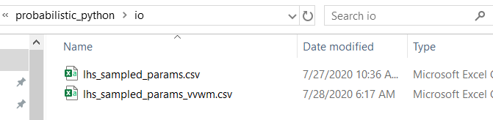
/lhs_sampled_params.csv
/lhs_sampled_params_vvwm.csv
Files of Importance
Both files contain the resulting variable values from the LHS. These values are used during the probabilistic process.

Slide 22
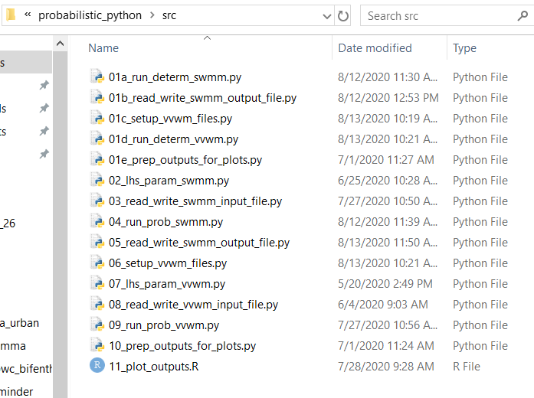
Files of Importance
File names should explain the main objective of the script.
Script 11_ is incomplete.

Slide 23
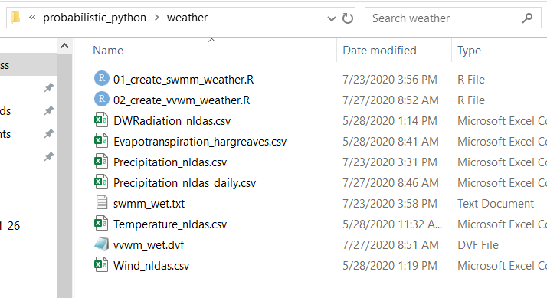
.csv files were downloaded from HMS to create the weather files
Scripts 01_ and 02_ create the weather files in their necessary format
swmm_wet.txt
File of Importance
SWMM weather file
vvwm_wet.dvf
File of Importance
VVWM weather file

Slide 24
Google Drive Folder Organization
The following slides explain and provides links for important documents and folders within the "Pleasant Creek SA" google folder

Slide 25
Game Plan
Explains the methods and thought process behind the methods
Contains links to multiple other docs within the google folder
I recommend you familiarize yourself with this doc (and the docs that are linked)
Manuscript Folder
Rough draft
Literature Reviews, references cited
There are 5 folders (SWMM Literature Review - #)
I went through several literature review cycles as I learned more about the project and as I sought to review certain topics
SWMM Literature Review – 3 and SWMM Literature Review – 5 contains the most relevant and cited research

Slide 26
Contact Information
If you have any questions, please contact me at echelsvig@gmail.com

